Slide 1
Traffic Signs Recognition
CNN (Convolutional Neural Networks)

Slide 2
Introduction
An automatic TSDR system can detect and recognise traffic signs from and within images captured by cameras or imaging sensors.
In adverse traffic conditions, the driver may not notice traffic signs, which may cause accidents. In such scenarios, the TSDR system comes into action.

Slide 3
History
first work on automated traffic sign detection was reported in Japan in 1984.
This attempt was followed by several methods introduced by different researchers to develop an efficient TSDR system and minimize all the issues.
An efficient TSDR system can be divided into several stages: preprocessing, detection, tracking, and recognition. In the preprocessing stage the visual appearance of images has been enhanced.

Slide 4
Traffic Signs Recognition
It is a technology by which a vehicle is able to recognize the traffic signs put on the road e.g. "speed limit" or "children" or "turn ahead".
The technology is being developed by a variety of automotive suppliers. It uses image processing techniques to detect the traffic signs.
The detection methods can be generally divided into color based, shape based and learning based methods.

Slide 5
Detection Methods
Traffic sign detection method are inherently dependent on the nature of data for which they were developed.
The approached that we are going to follow in the detection stage have
Traditionally been divided into two kinds :
Color based methods
Shape based methods

Slide 6
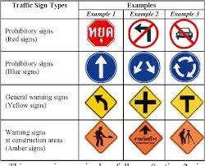
Color base detection

Slide 7
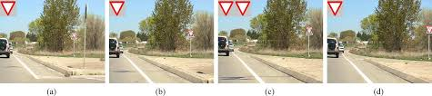
Shape based methods

Slide 8
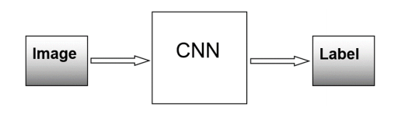
Image processing by CNN
CNN is a class of deep neural network that is mostly used in the field of computer vision and imaging. CNNs are used to identify images, cluster them by their similarity, and implement object recognition within scenes.

Slide 9
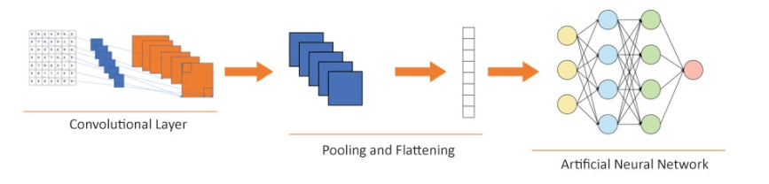
The Architecture of a CNN
The main components of CNN architecture are as follows: • Input image • Convolutional layer • Pooling layer • Flattening

Slide 10
Execution of the model
Using following architecture to execute the CNN Model-
• Adding CNN layers • Adding ANN layers • Changing the optimizer function • Changing the activation function

Slide 11
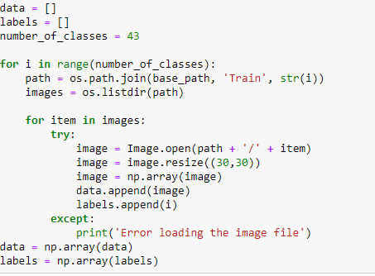
Model Preprocessing

Slide 12
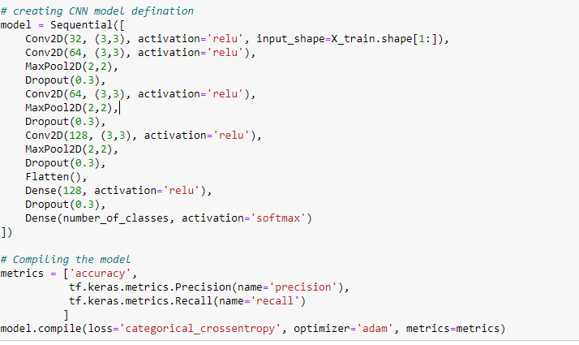
Building Model

Slide 13
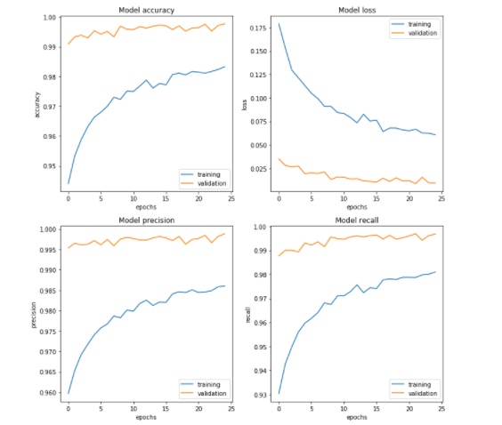
Result

